Slide 1

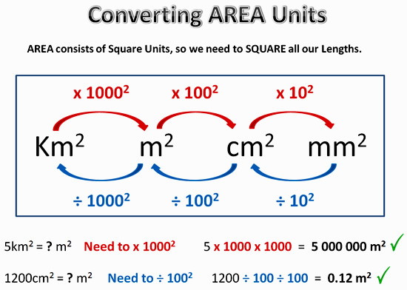
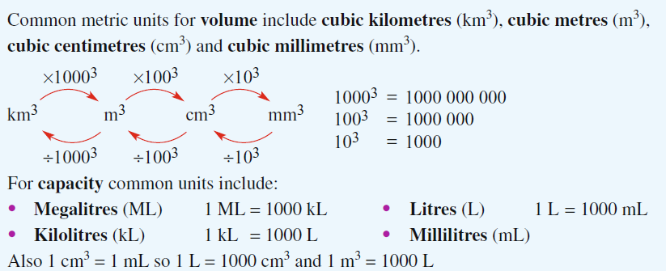
My Measurement Interactive Notebook
Name
Class
Teacher
Term
1

Slide 2
Contents
Glossary or Formula Page
Page
Date
Description
2
3

Slide 3
Tasks
24
7
30
Essential Question
Questions
Notes
Summary
6
7

Slide 4
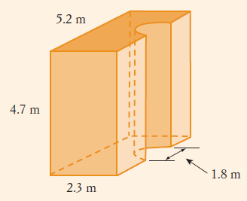
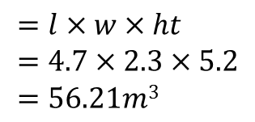
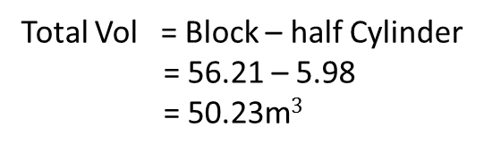
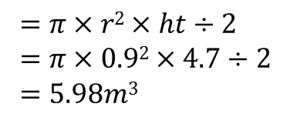
24
7
30
Date
Total Surface Area and Volume Composite Shapes
EQ – Describe how to find the Total Surface Area & Volume of different composite shapes.
How do we find the volume and TSA of 3 dimensional shapes?
Find the Volume of this shape and we need to paint it so you will also need to find the total surface area as well?
Volume – find the volume of the main block and take the shape out ie. half cylinder.
Vol of Block
$$=l×w×ht \\ =4.7×2.3×5.2 \\ =56.21m3$$
Vol of half cylinder to take out
$$=π×r2×ht÷2 \\ =π×0.92×4.7÷2 \\ =5.98m3$$
Total Vol = Block – half Cylinder
= 56.21 – 5.98
= 50.23m$3$

Slide 5
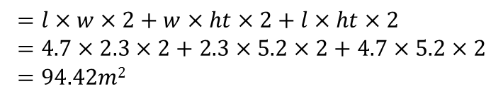
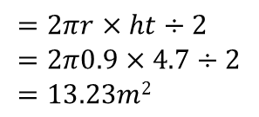
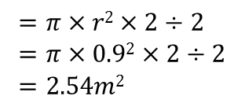
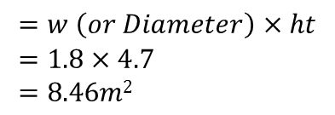
24
7
30
Date
Total Surface Area and Volume Composite Shapes
EQ – Describe how to find the Total Surface Area & Volume of different composite shapes.
How do we find the volume and TSA of 3 dimensional shapes?
Find the Volume of this shape and we need to paint it so you will also need to find the total surface area as well?
Volume – find the Total Surface Area.
Surface Area of Block
$$=l×w×2+w×ht×2+l×ht×2 \\ =4.7×2.3×2+2.3×5.2×2+4.7×5.2×2 \\ =94.42m2$$
Subtract
Area of Rect made by half cylinder
$$=w \left(or Diameter\right)×ht \\ =1.8×4.7 \\ =8.46m2$$
Add
Subtract
Area curved surface made by half cylinder
Area of 2 half circles made by half cylinder
$$=2πr×ht÷2 \\ =2π0.9×4.7÷2 \\ =13.23m2$$
$$=π×r2×2÷2 \\ =π×0.92×2÷2 \\ =2.54m2$$
Total Surface area = 94.42 – 8.46 – 2.54 +13.23 = 96.65m²

Slide 6
24
7
30
Date
Total Surface Area and Volume Composite Shapes
EQ – Describe how to find the Total Surface Area & Volume of different composite shapes.
How do we find the volume and TSA of 3 dimensional shapes?
Do exercise 3.3 and 3.4 page 36 & 37 Dwyer book

Slide 7
Notes Review
24, 7 ,30
Date
Title
Essential question
Notes complete
Notes complete with colour and diagrams
Questions completed
Contents page filed in
Formula page filled in

Slide 8
Homework
Review your notes and write a summary answering the essential question.

